Slide 1

Neural-Based Hierarchical Approach for Detailed Dominant Forest Species Classification by Multispectral Satellite Imagery
AUTHORS: SVETLANA ILLARIONOVA, ALEXEY TREKIN, VLADIMIR IGNATIEV, IVAN OSELEDETS

Slide 2
INTRODUCTION
Background of forest species classification: Dominant species crucial for forest management
Challenges: Traditional methods (manual, satellite mapping, LIDAR) time-consuming
Paper's focus: Introduction of neural-based hierarchical approach for efficiency

Slide 3
Motivation
Importance of defining dominant species for accurate forest management
Need for a cost-effective remote sensing-based approach
Paper's role in addressing these challenges

Slide 4

CONTRIBUTION
Identification of biases in existing AI models for forest species classification
Inadequacy of guardrails in reducing biases
Significance of the paper's findings in advancing the field

Slide 5

METHODOLOGY
Hierarchical set of binary classification tasks: Multiclass segmentation as binary segmentation problems
Use of WorldView multispectral satellite imagery for detailed classification
Overview of six neural network architectures: ResNet, Inception-ResNet-v2, EfficientNet

Slide 6

RESULTS
Experimental results in Leningrad Oblast, Russia
Performance comparison: Hierarchical approach vs. multiclass classification
Superior performance of proposed approach (average F1-score 0.84)

Slide 7

LIMITATIONS
First limitation: Limited number of tools, potential issues with other tools
Second limitation: Mention of any additional constraints

Slide 8

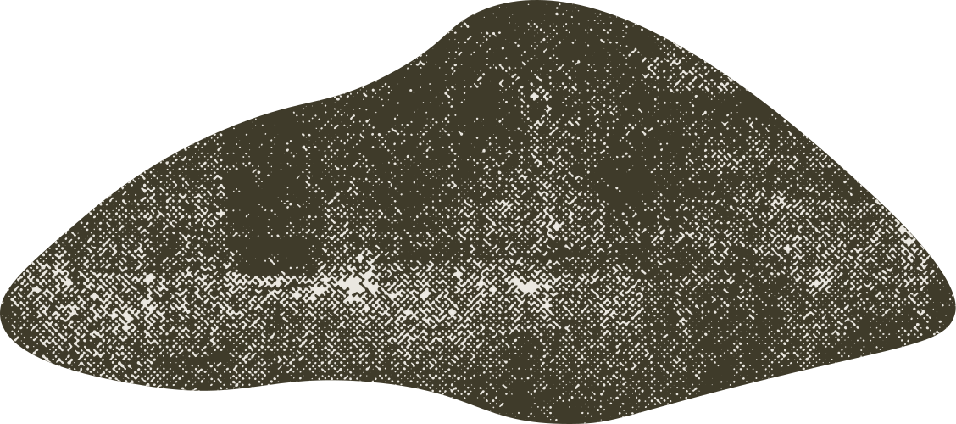

SYNTHESIS
Broader impact: Issues affecting society, implications for tool developers and users
Society's reliance on biased tools: Impact on decision-making, potential societal biases

Slide 9
CONCLUSION
KEY FINDINGS SUMMARY: NEURAL-BASED HIERARCHICAL APPROACH EFFECTIVENESS
DATASET AVAILABILITY: OPEN-SOURCE DATASET FOR FUTURE RESEARCH
REINFORCEMENT OF PAPER'S CONTRIBUTIONS TO THE FIELD

Slide 10
FUTURE WORK
Extension of hierarchical approach to cover mixed forest cases
Addition of more forest inventory characteristics: Further enhancement of satellite imagery analysis

Slide 11
Q&A
Feel free to let me know if there are specific technical details you'd like to emphasize or any other adjustments you have in mind.

Slide 12

Thank You

Slide 13
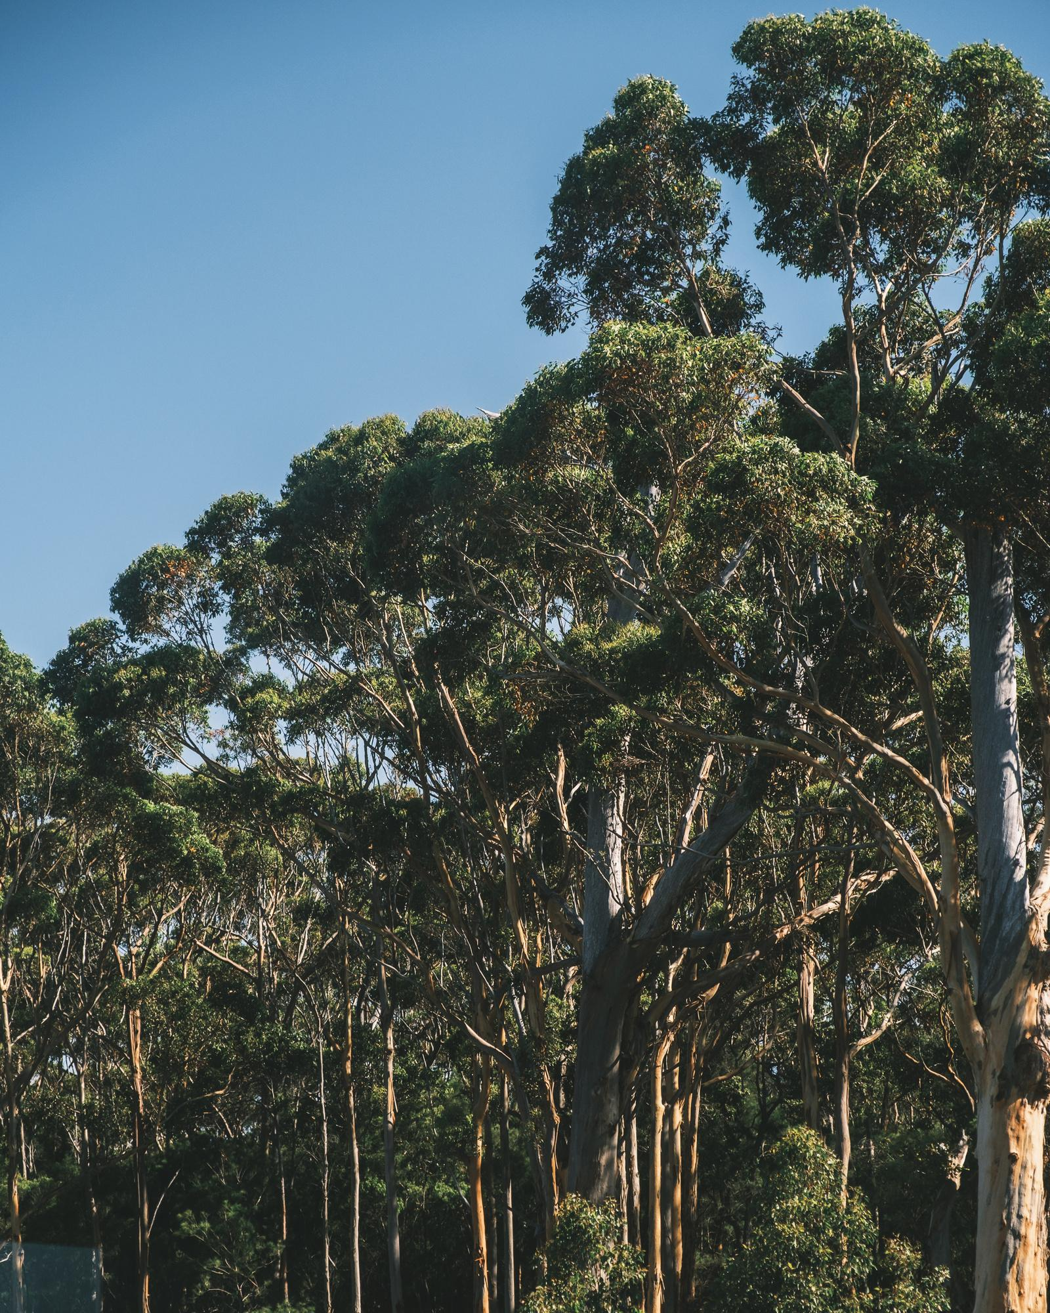

Introduction
Forests crucial for climate stability
Efficient monitoring through remote sensing
Role of deep learning in revolutionizing forest monitoring

Slide 14

Motivation
Need for accurate and efficient forest cover monitoring
Shift from manual interpretation to AI-based methods

Slide 15


Contribution
Addressing challenges in tree segmentation
Introduction of deep learning for improved accuracy

Slide 16



Methodology
Large-scale experiments with multispectral imagery
Benchmarking deep semantic segmentation architectures
Exploration of hand-crafted spectral vegetation indices

Slide 17

Results
Experimental outcomes on DSTL and RIT-18 datasets
Comparison of deep learning models and traditional Random Forest

Slide 18

Limitations
Importance of high spatial resolution for accurate segmentation
Sensitivity of NIR reflectance in achieving precise results

Slide 19
Synthesis
Superiority of DLinkNet in handling occlusion and grassland
Advantage of combining diverse spectral bands for improved performance

Slide 20

Conclusions
Significance of spatial resolution in segmentation accuracy
Recommendation for domain-specific pretrained encoders

Slide 21


Future Directions
Focus on improving backbone architecture
Exploration of vision transformers for enhanced performance

Slide 22
Q&A
Open floor for questions and discussions
Feel free to adjust the content according to your preferences or add specific details that are important for your presentation.

